Slide 1



LAW FIRM DATA Report
View in Power BI
Last data refresh:
5/26/2024 7:39:55 AM UTC
Downloaded at:
7/6/2024 8:04:32 PM UTC

Slide 2
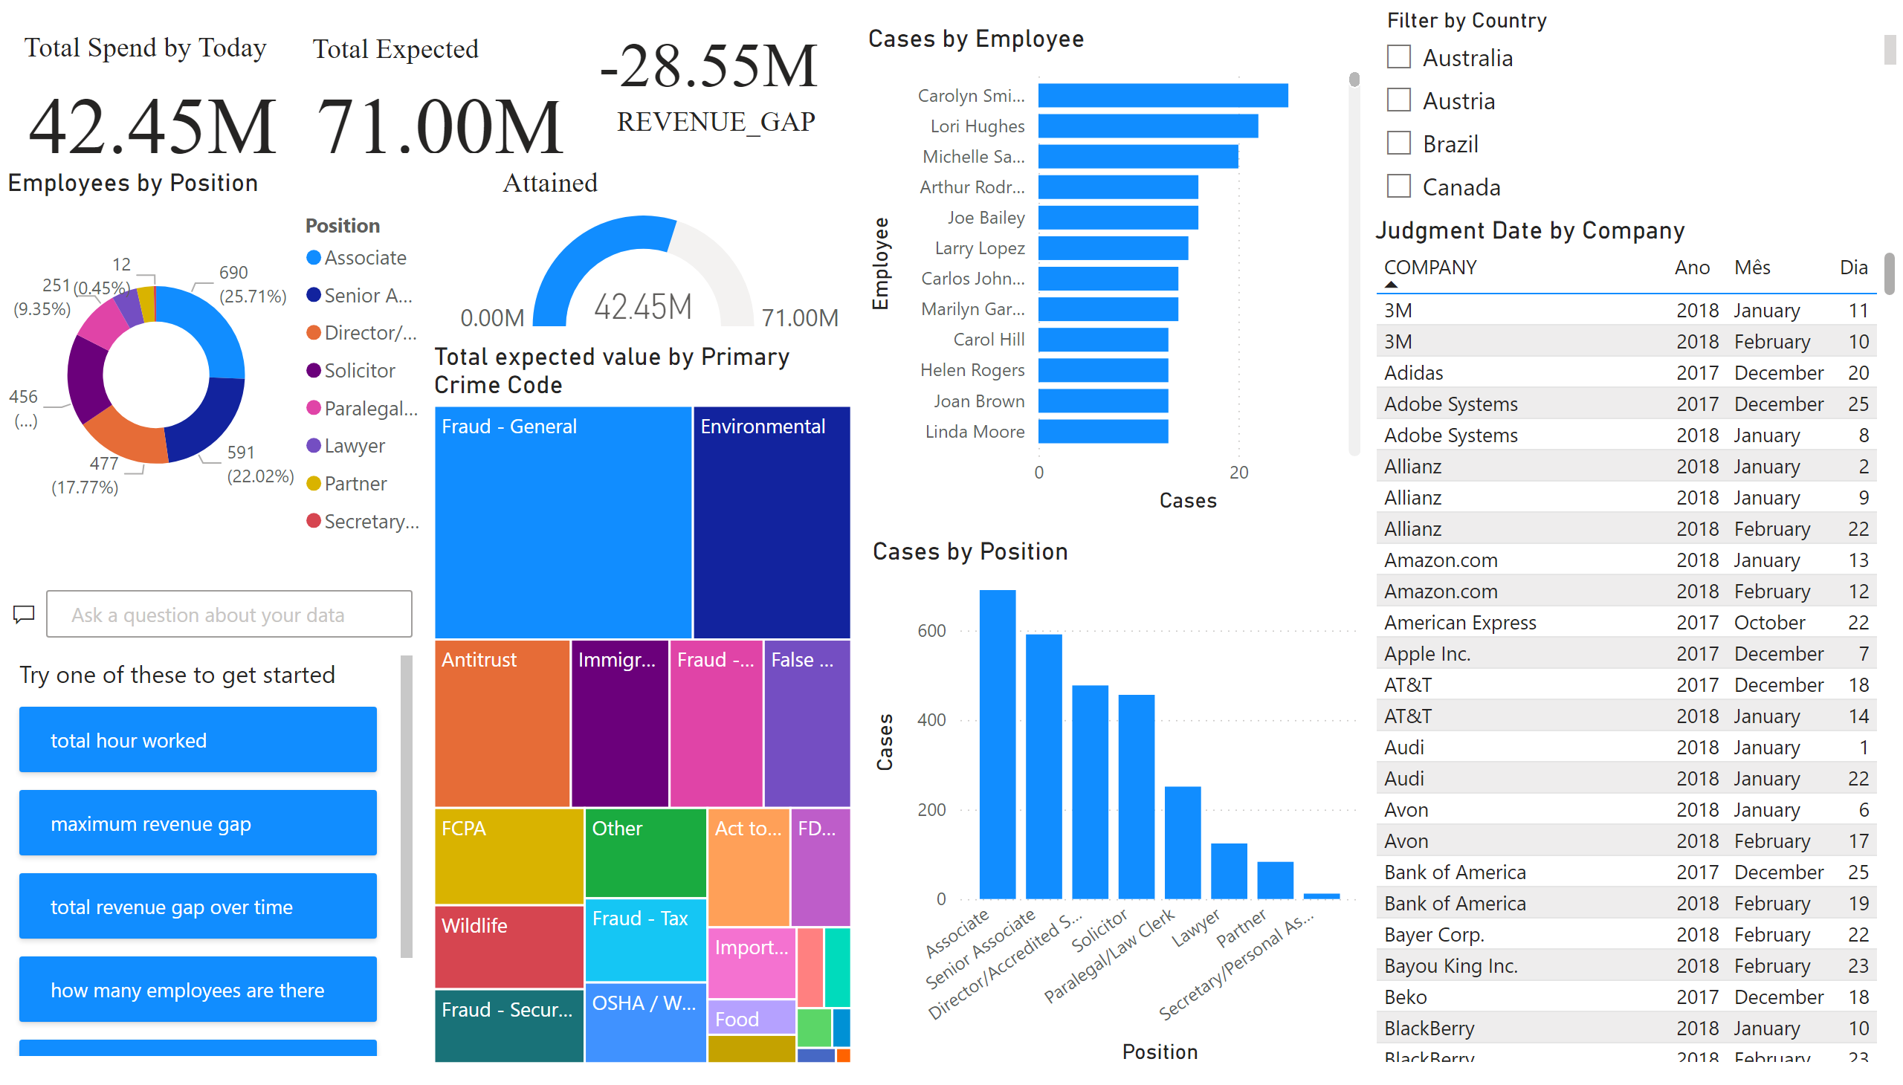
Overview
Notes:
slicer
No alt text provided
qnaVisual
No alt text provided
treemap
No alt text provided
donutChart
No alt text provided
clusteredColumnChart
No alt text provided
barChart
No alt text provided
Judgment Date by Company
No alt text provided
textbox
No alt text provided
textbox
No alt text provided
card
No alt text provided
gauge
No alt text provided
card
No alt text provided
textbox
No alt text provided
card
No alt text provided
textbox
No alt text provided

Slide 3
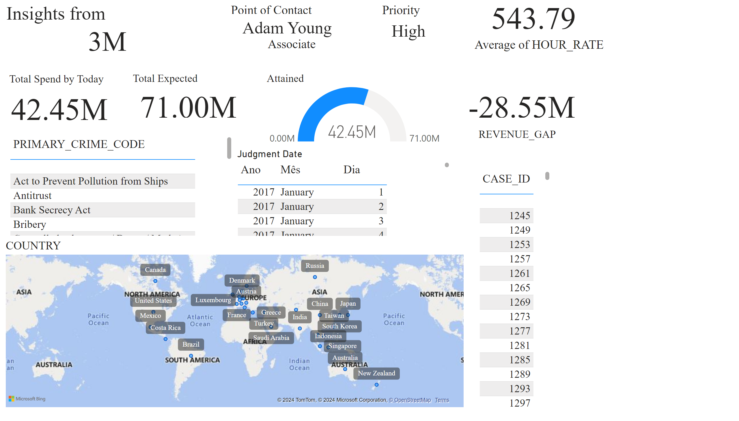
Clients
Notes:
textbox
No alt text provided
card
No alt text provided
textbox
No alt text provided
card
No alt text provided
card
No alt text provided
textbox
No alt text provided
textbox
No alt text provided
card
No alt text provided
textbox
No alt text provided
card
No alt text provided
gauge
No alt text provided
Judgment Date
No alt text provided
card
No alt text provided
textbox
No alt text provided
card
No alt text provided
card
No alt text provided
textbox
No alt text provided
tableEx
No alt text provided
tableEx
No alt text provided
map
No alt text provided
textbox
No alt text provided

